Slide 1
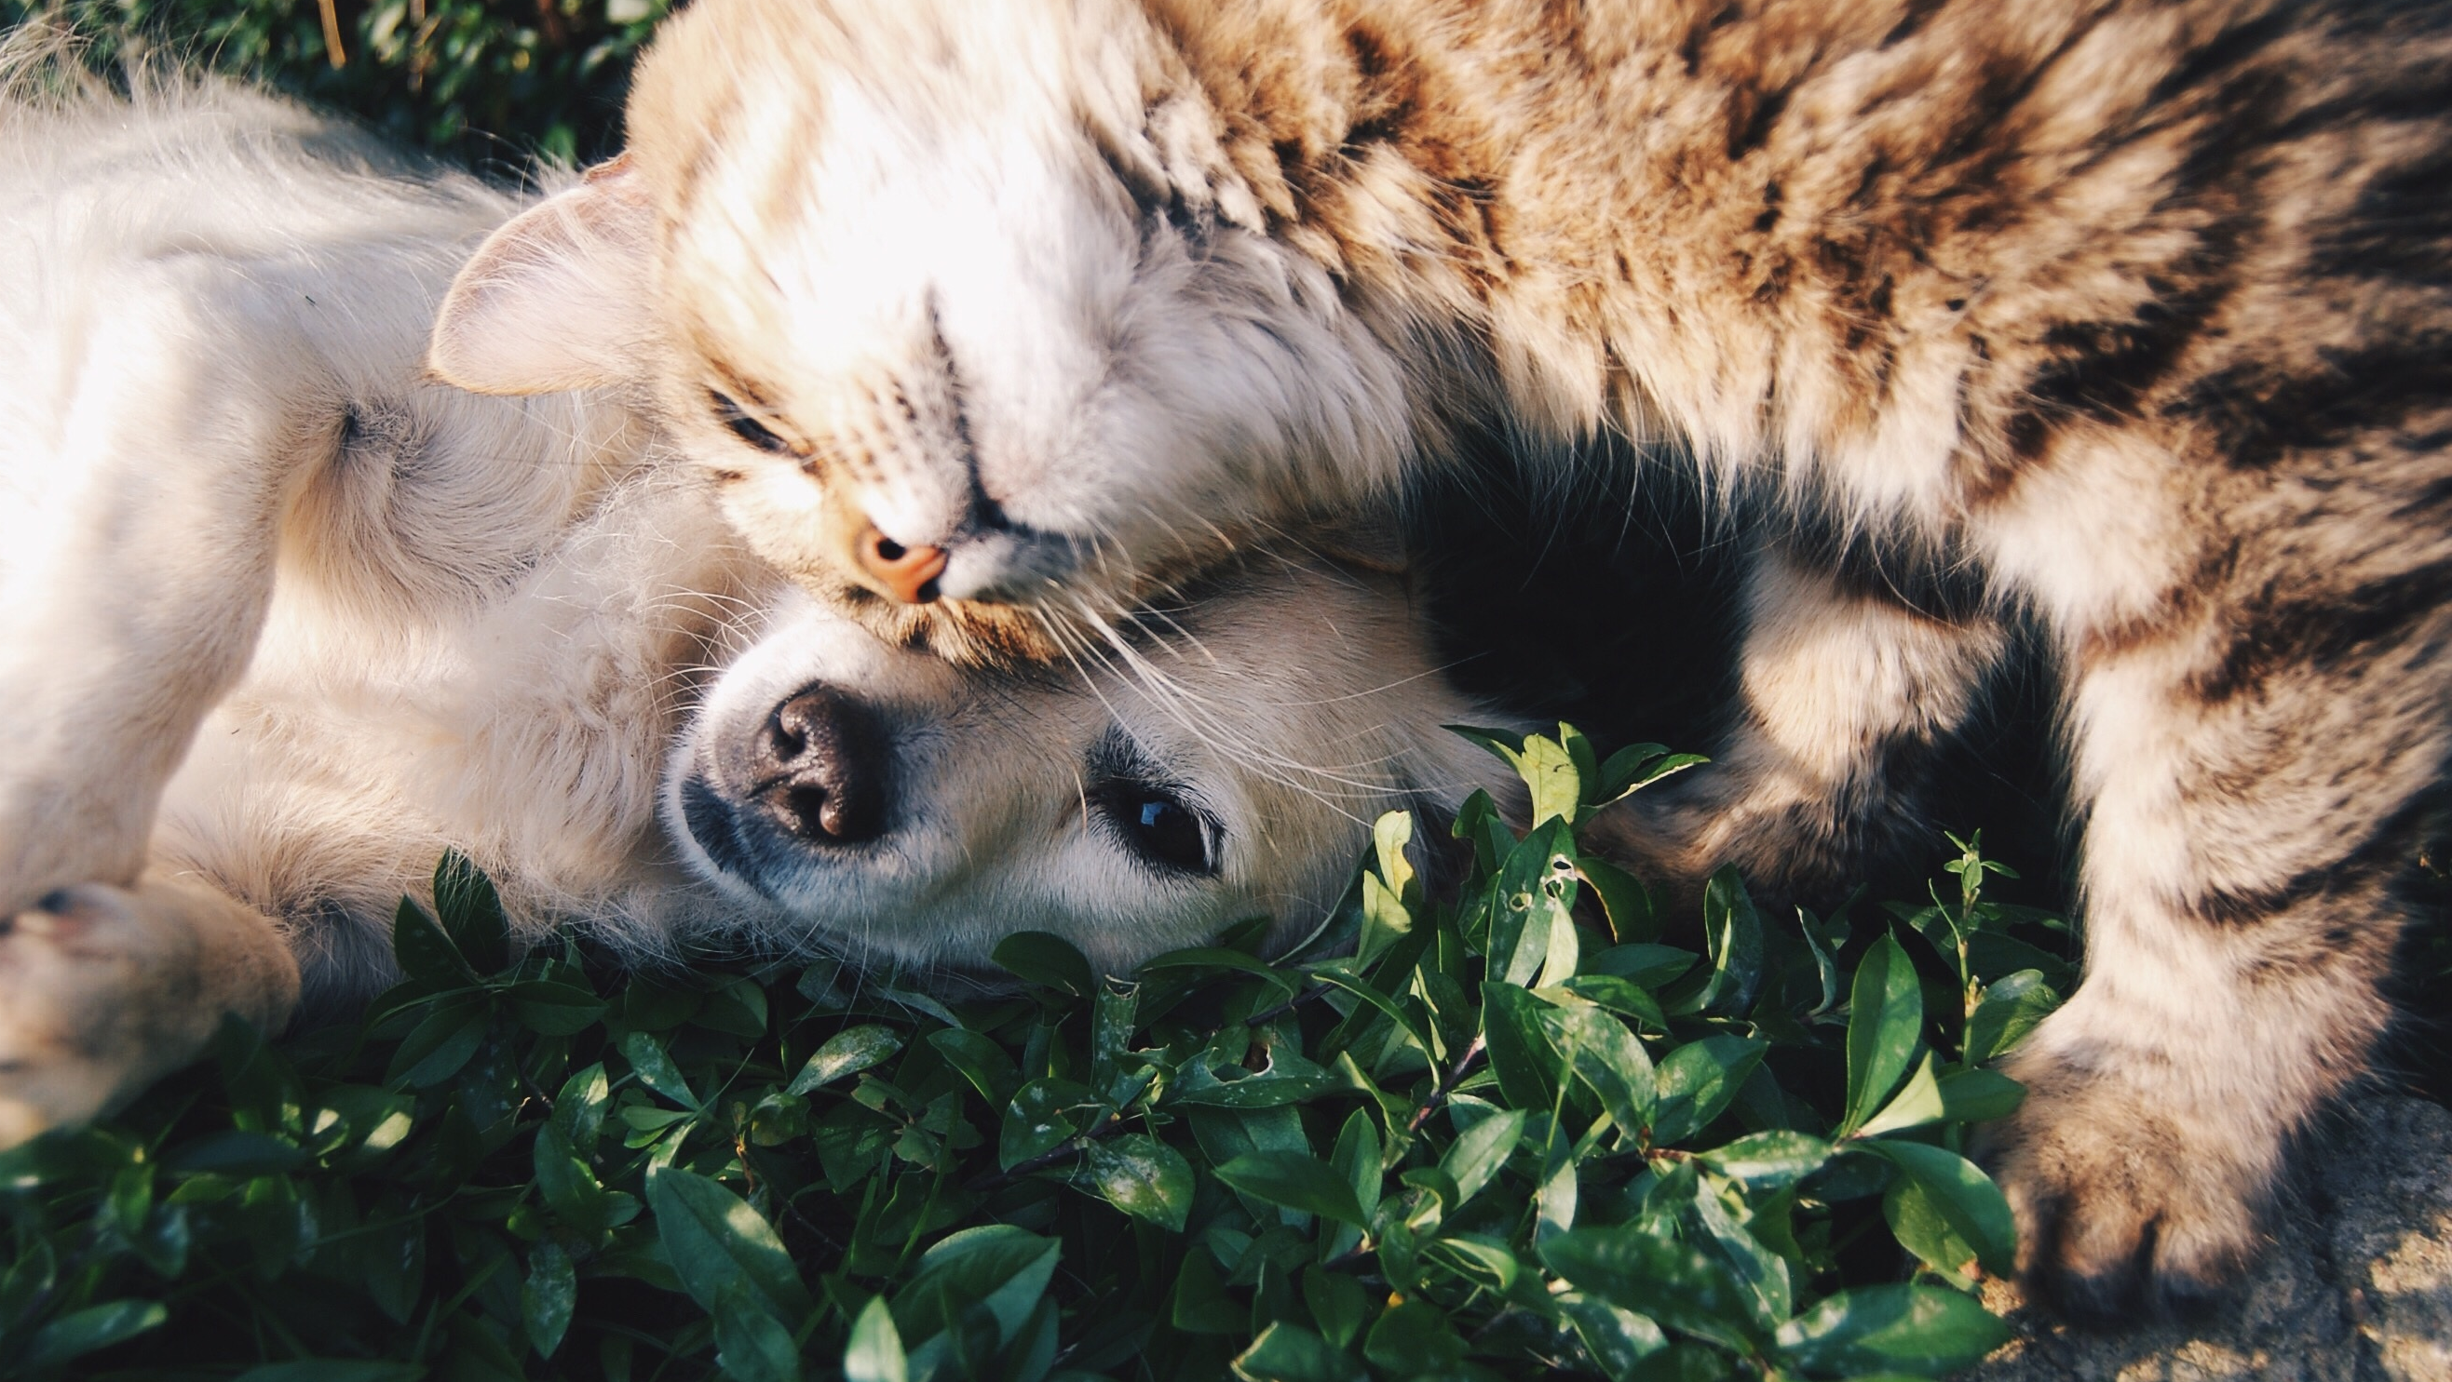
Animal Shelter Trends for Cats and Dogs
By Pontiac
Notes:
A: Hello everyone and welcome to the presentation!
We are team Pontiac, and our focus will be on animal shelter trends for cats and dogs.

Slide 2

Introductions

Slide 3
Ardita Musovic
Bachelor of Science in Computer Science
Employed as a Data Analyst for the NYC Department of Education
Many years of experience as Technical Support
Wanted to upskill to improve and enhance data expertise
Loves playing video games and baking, and enjoys health and fitness
Owner of two dogs
Notes:
I have a Bachelor of Science degree in Computer Science
I previously worked as a Data Analyst for 3 years at the NYC Department of Education, where I utilized my skills in Excel, VBA, Google Sheets and BigQuery
I have also worked as a Technical Support Analyst for over 3 years at my college and at a start-up
I wanted to upskill from being a Data Analyst to a Data Scientist in order to improve and enhance my expertise, and ultimately improve work-life balance
In my free time, I love playing video games and baking. I like to keep a steady workout routine and enjoy learning about health and fitness
I have 2 dogs, a crazy German shepherd and a timid Pitbull mix.

Slide 4
Sarah Schluter
RN for 20 years working on a second career
AAAS and ADN degrees
Has extensive experience in forensics
Appreciates the importance of data analysis in improving lives and processes
Needed a better life-work balance
Has a love for cooking, trying new foods, painting and writing
Owner of two cats
Notes:
RN for 20 years working ER, ICU, and Psychiatric
Worked much of my career in forensic psych- pretrial motions for competency to stand trial and restoration to competency
Developed an intense curiosity about studies and statistics through my work as an RN after being presented repeatedly over the years regarding patient safety and best practices
I wanted to break away from hospital work without losing income to focus on my life- I needed to stop working my life around my job and have a better balance
I love cooking and trying new foods, painting, and writing

Slide 5
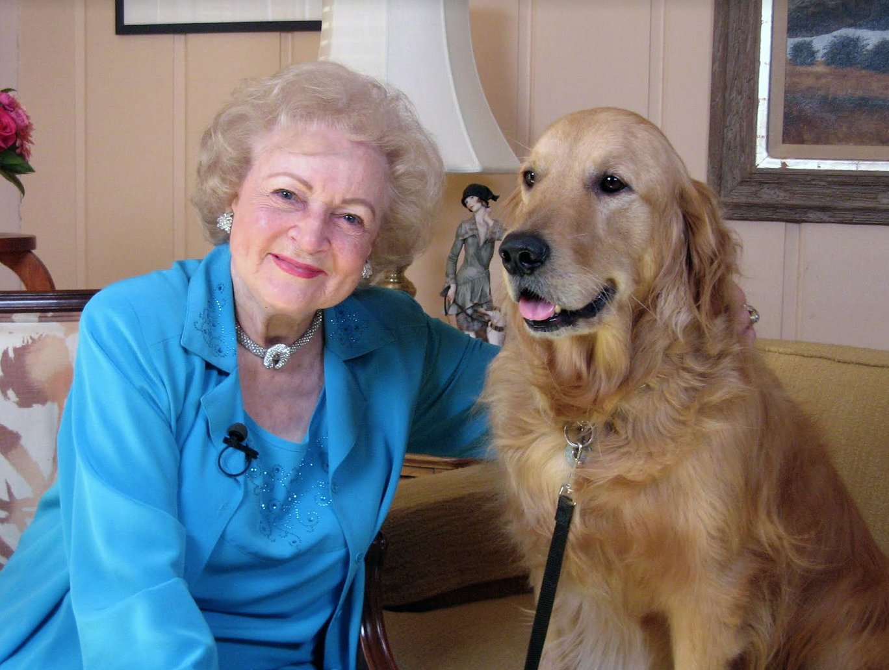
Who is Pontiac?
Betty White’s rescue dog
Failed Seeing Eye Dog training
Notes:
S: You might be wondering, "Why is our team's name Pontiac?". Betty White had one pet several years prior to her death, a golden retriever named Pontiac who had originally worked as a guide dog with ​​Guide Dogs for the Blind, an organization Betty had supported for years. The "career change" dog dropped out of the guide dog program because he was too friendly — he would run to greet everyone he saw as he walked down the street, according to Today.

Slide 6
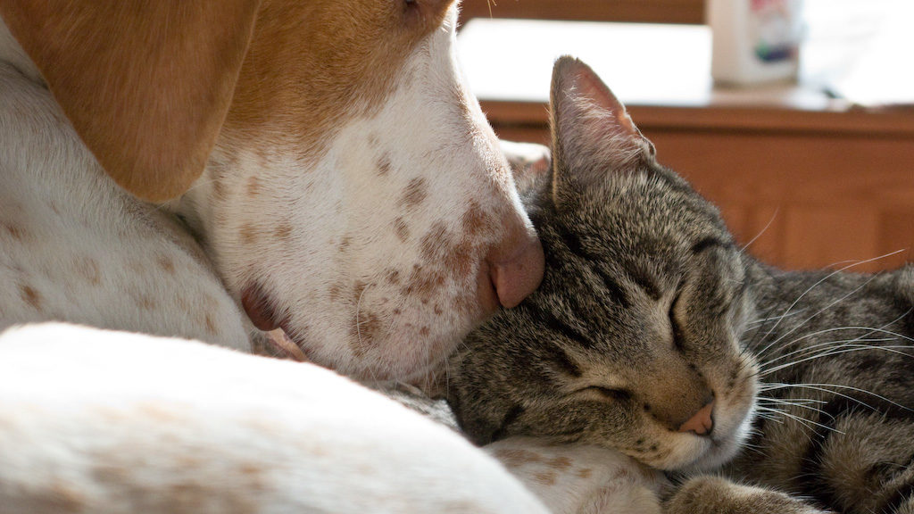
Why animal shelters?

Slide 7
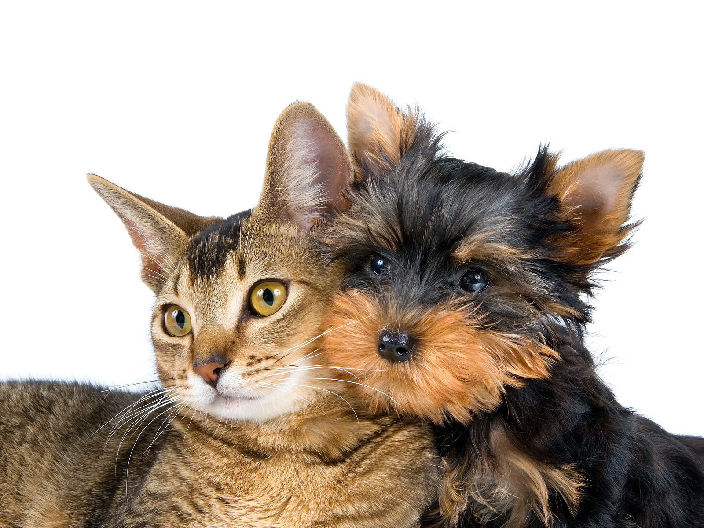
Our Mission: Raise awareness
Notes:
S: As animal lovers, we want to help shelters combat issues they face by raising public awareness and spreading information.
Oftentimes, people will purchase a pet and end up surrendering them to a shelter for various reasons. Meanwhile there is a surplus of cats and dogs available in shelters.

Slide 8
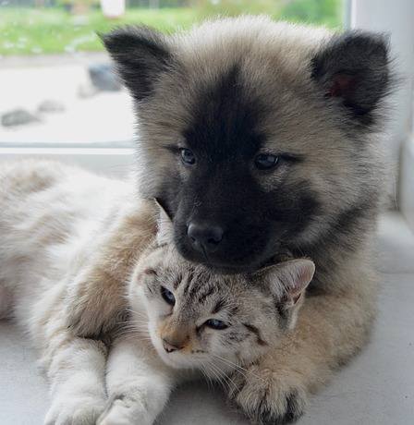
Biased and false views regarding the many issues facing shelters in bringing forever homes and abandoned animals together
Notes:
S: Animal shelters have many challenges facing them in their quest to unite abandoned animals with good homes.
Battling people’s preconceived notions about rescue pets, public ignorance over curbing animal overpopulation, lack of centralized funding for these non-profit shelters, and the staggering number of animals all contribute to a veritable host of problems to surmount.

Slide 9

Methods

Slide 10
Evaluation Questions
Which time of the year are cats and dogs more likely to get adopted?
Did Covid-19 effect adoption rates?
Which age groups of cats and dogs have the highest adoption rates?
What are the most common reasons cats and dogs are taken into a shelter?
Has the amount of stray cats and dogs changed over time from 2018 to 2021?
Can we create predictive modeling to reliably predict cat and dog adoptions?
Notes:
S: Through our data journey, we wanted to find out which factors impacted cat and dog shelter trends. This included if certain months of the year saw higher adoption rates, whether Covid had an impact on adoption rates, if age played a role in adoptions, which factors most influenced shelter intakes, and if stray intakes changed over time. We were also curious to see if we could predict cat and dog adoptions accurately with predictive modeling.

Slide 11
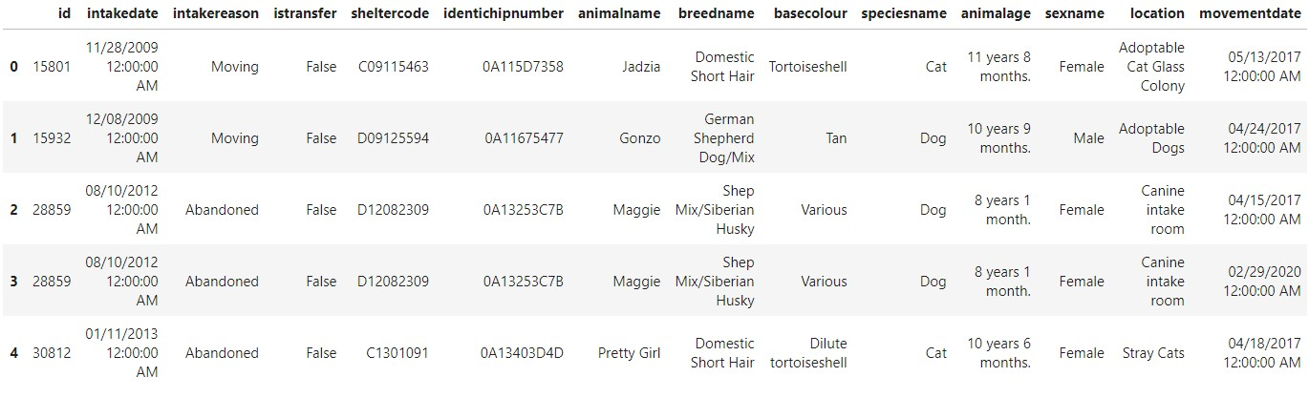
Where did this data come from?
City of Bloomington Open Data – Bloomington Animal Shelter (Bloomington, Indiana)
19399 rows and 23 columns
Notes:
S: This data was retrieved from the City of Bloomington Open Data provided by Bloomington Animal Care & Control in Indiana.
In early 2017, the Bloomington Animal Shelter migrated their management software and attempted to preserve as much information as possible from the old system.
In our search for data, finding an appropriate animal shelter dataset proved to be challenging. Many datasets we came across were lacking certain information, were too old, had not been updated in over a year, or were not available to access without payment.
Of the 19399 row entries, over 18000 entries pertained to cats and dogs at almost a 2:1 ratio. There were 11708 cat entries and 6661 dog entries. We decided to only analyze shelter information for cat and dog species.

Slide 12

Data Wrangling
Python
Dropped NAs, blanks and unknowns
Recoded Movement and Intake Dates to Month, Day, Year
Kept only cat and dog species
Made dictionaries for CatAgeGroups and DogAgeGroups
Combined intake variables that had the same meaning
Created new CSV files after wrangling
Notes:
A: All of our data wrangling was performed with Python in Jupyter Notebook.
We cleaned and wrangled the data as needed by dropping NAs and blanks, recoding dates by removing timestamps then splitting the dates into 3 separate columns, keeping only cat and dog species in the dataset, and making age group dictionaries for over 300 age entries. Ultimately, we had a final CSV file that we exported from our wrangled data to use as our main data source.

Slide 13

Analyses
Python and R
Expected analyses:
Binary Logistic Regression
Independent Chi-Square Test
MANOVA
McNemar Chi-Square
Bhapkar Test
Actual analyses:
Two Independent Chi-Square Tests
Frequency and Percent
McNemar Chi-Square
Notes:
A: When we were initially figuring out the appropriate analyses for our evaluation questions, we determined we would be completing a few various analyses.
As we moved through the weeks of the project, we re-evaluated our questions and decided that perhaps there were more suitable analyses that we could use.
At one point, we attempted to use the Bhapkar Test, which was not covered in our data science course material, and then realized that this particular analysis was not appropriate for the data we had and so we ruled it out.
We successfully completed 3 out of 4 analyses in Python, and the McNemar Chi-Square was done in R.

Slide 14

Visualizations
Python and Tableau
Exploratory analysis
Predictive modeling
Bar graphs and line graphs
Notes:
A: During exploratory analysis, we created bar graphs and histograms to get a better understanding of our data. Additionally, we utilized bar graphs in our predictive modeling for easy-to-read graphics.
Tableau proved to be very helpful in narrowing our focus and highlighting interesting data via bar and line graphs.

Slide 15

Results

Slide 16
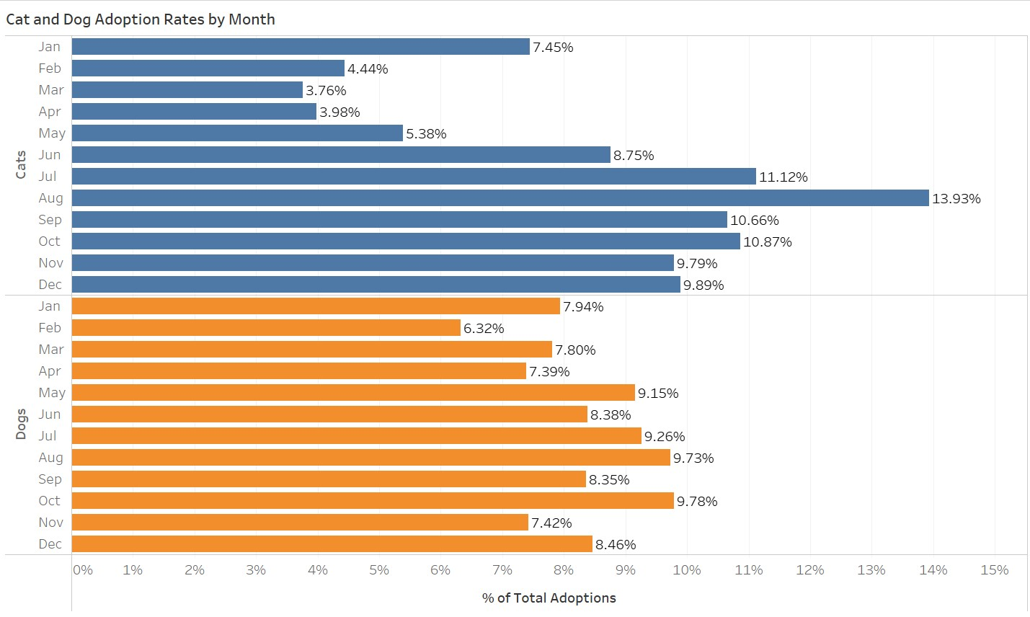
Notes:
A: When we started to visualize our dataset, we found some interesting differences between cats and dogs.
At a glance, dog adoption rates were more evenly distributed than cat adoption rates. Cats had the highest adoption rates in August, by far, at 13.93%, while March and April had the lowest overall adoption rates, at about a 4% rate each.
Dogs had the highest adoption rates in August and October, both at around 9.7%. February had the lowest adoption rates for dogs at 6.32%.
We hypothesized that more cats and dogs would be adopted around December due to the Holiday Season, but that didn't seem to be the case.

Slide 17
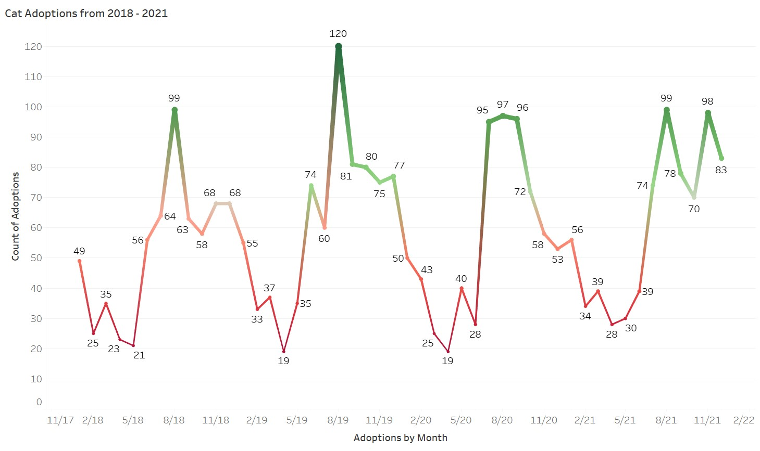
Notes:
A: Let's take a look at cat adoptions from 2018 to 2021. The highest number of adoptions occurred in August throughout all four years, with August 2019 having the highest peak.
The lowest number of adoptions typically occurred in April, with April 2019 and April 2020 having the lowest dip in adoptions.
The trends in adoption rates were consistent throughout these years.

Slide 18
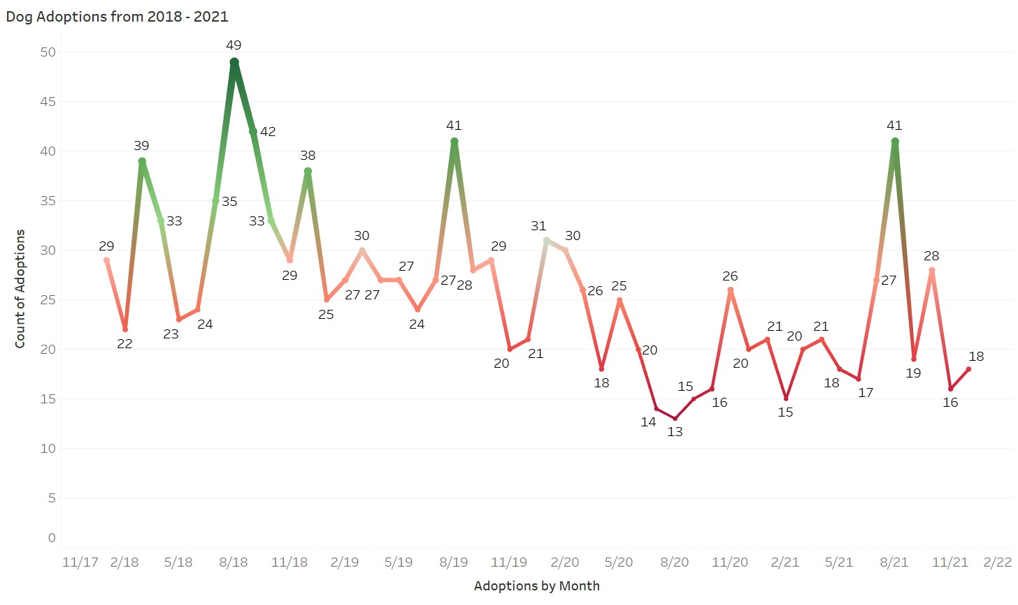
Notes:
A: As for dogs, we can see that they had the highest adoptions occur in August for all years except 2020. The highest peak was in August 2018.
Curiously, August 2020 had the lowest dip in adoptions, and there seemed to be a downward trend for the year of 2020.
We're not sure if Covid had an impact on the dip and downward trend during this year.

Slide 19
Covid-19 and Adoptions
No specific factors could be tied between Covid-19 and adoptions
The data didn't lend itself well enough to evaluate the question
Question was abandoned
Notes:
S: As we worked with our data, we came to the realization that not all of our questions could be answered at this time.
When we scrutinized the data in this dataset, we simply could not tie Covid as a specific factor in adoption rates with the data provided.

Slide 20
Cat Age Groups
Dog Age Groups
Kitten (Birth until 7 months)
Adolescent (8 months to 2 years)
Adult (2 to 6 years)
Mature (7 to 10 years)
Senior (11 to 14 years)
Geriatric (15+ years)
Puppy (Birth until 7 months)
Adolescent (8 months to 2 years)
Adult (2 to 5 years)
Mature (6 to 8 years)
Senior (9 to 11 years)
Geriatric (12+ years)
Notes:
S: When it came to analyzing adoptions by age groups, the first thing we had to do was determine how to define the parameters for each age group. We had a lot of information about years plus months, even weeks and days, but we needed to convey our message more generally in a way which people could understand it. Our solution was to define 6 different age categories for both cats and dogs.
There were some age entries that were mislabeled – such as 100 years old – but we made sure to categorize those ages as "Unknown" and drop them.

Slide 21
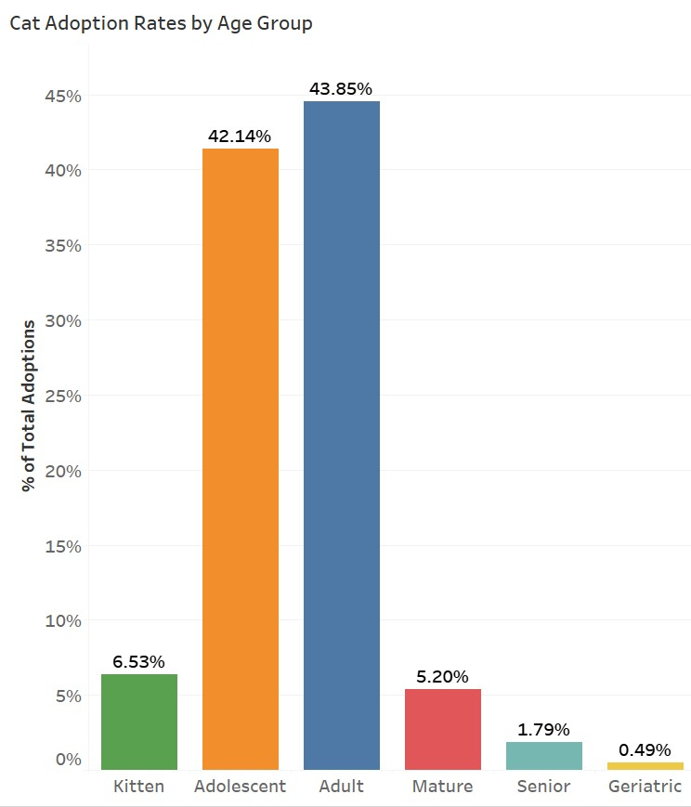
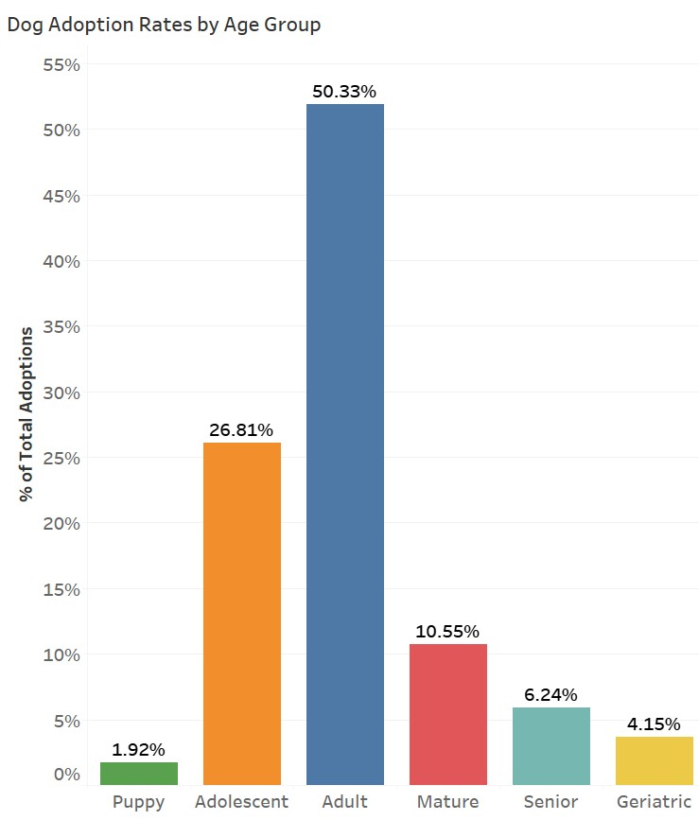
Cat Age Groups
Dog Age Groups
Notes:
S: We graphed adoption rates by age group, from youngest to oldest, and found that both Adult Cats and Adult Dogs had the highest adoption rates.
Most of the adopted cats were adolescents, age 8 months to 2 years, and adults, ages 2 to 6 years. Combined, they equaled about 86% of total cat adoptions.
It's not surprising that geriatric or senior cats and dogs are not as likely to be adopted, however we noticed that puppy adoptions had the lowest adoption rate in dogs. When we took a closer look at our data, we found that puppies represented one of the smallest portions of shelter intakes.

Slide 22
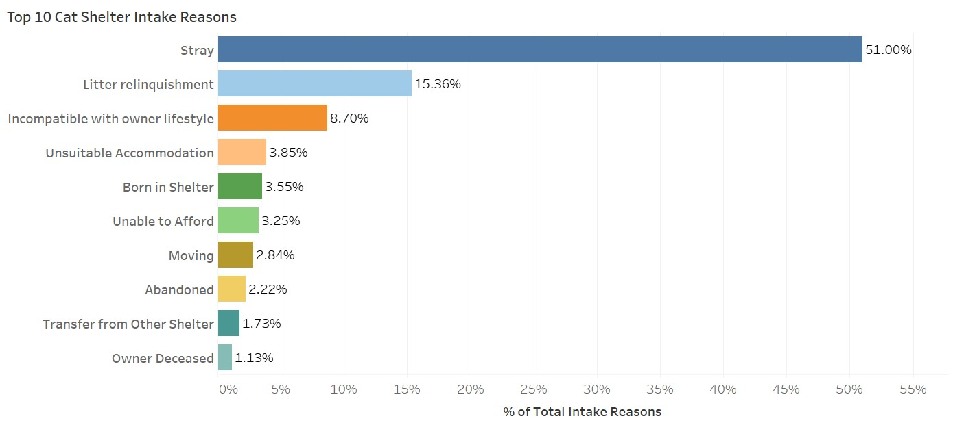
Top 10 Cat Shelter Intake Reasons
Notes:
A: We were curious to see the top 10 shelter intake reasons for both cats and dogs.
Stray cat intakes were the #1 reason by far, followed by litter relinquishments, incompatibilities with owner lifestyles, and unsuitable accommodations.
Some of the other intake factors included surrenders due to the cost of owning a pet, relocation, abandonment, and owner deaths.

Slide 23
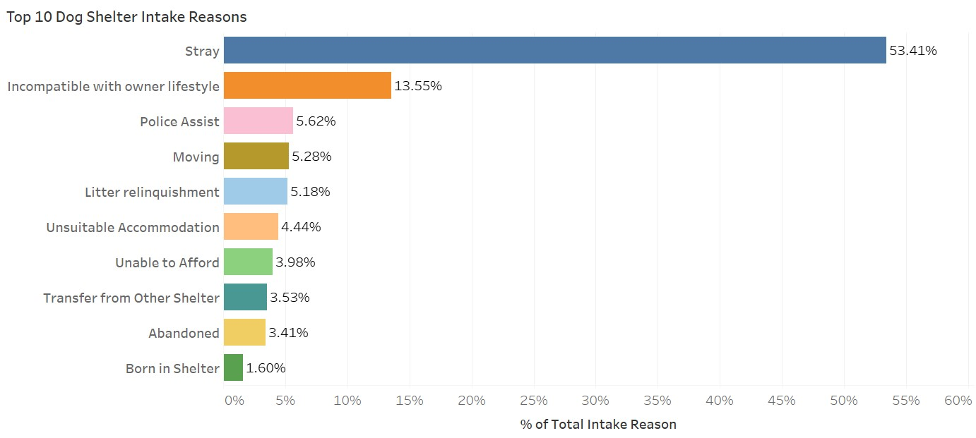
Top 10 Dog Shelter Intake Reasons
Notes:
A: The top 10 shelter intake reasons for dogs also included strays as the #1 reason, followed by incompatibilities with owner lifestyles, police assists, and moving.
Many of the other intake factors were similar to cats, such as litter relinquishments, unsuitable accommodations, and the cost of owning a pet.
These intake visualizations provided the most dramatic and surprising answers in this project.

Slide 24
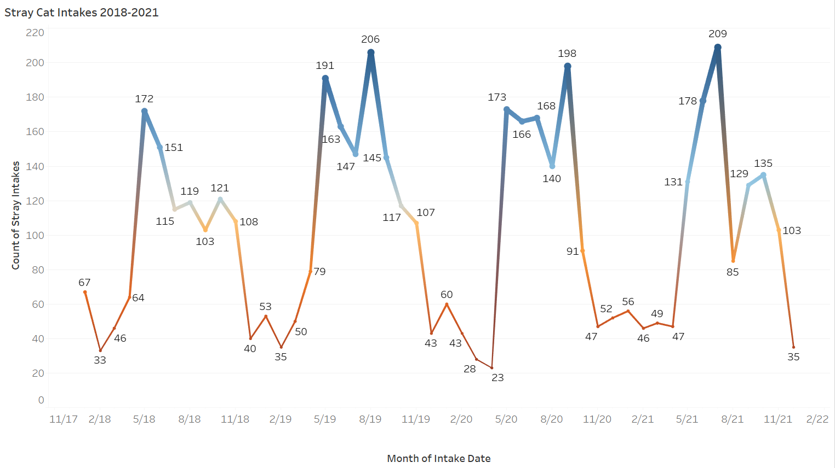
Month of Intake Date
Notes:
S: Since strays were the top reason that cats and dogs were taken into the shelter, we wanted to know if stray intakes changed over the course of a few years.
Originally, we were going to use 2015 to 2020 data, however there were some data gaps from the year 2017 and prior.
From 2018 to 2021, there were no significant changes in stray cat intakes. Peak stray intakes occurred in July 2021, and the lowest number of intakes were seen in April 2020. Most strays were taken in from the months of May through September, which are typically warmer months.

Slide 25
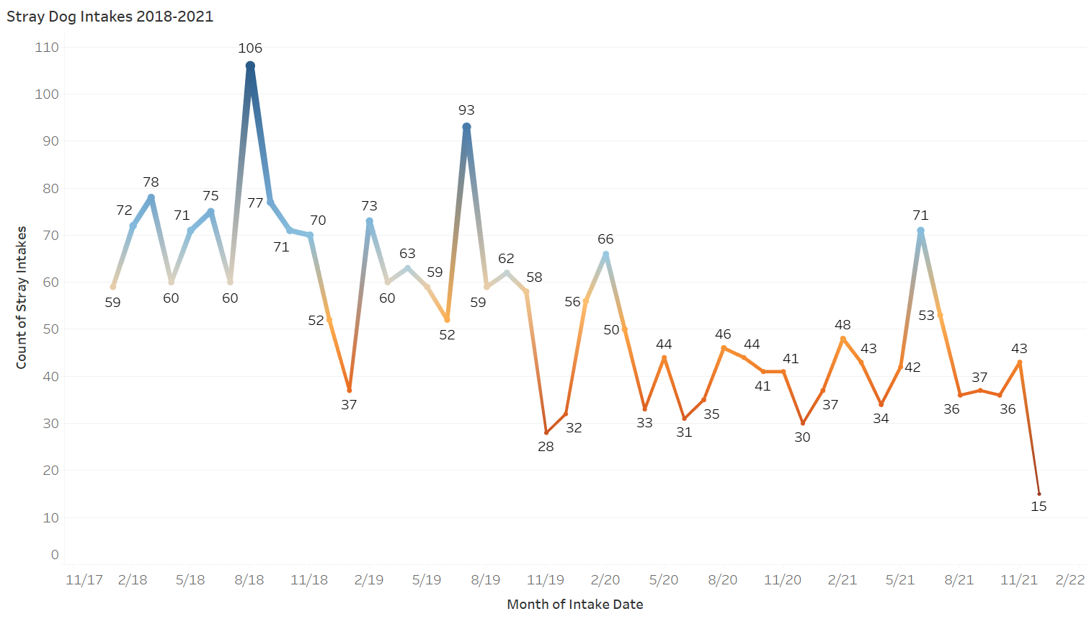
Month of Intake Date
Notes:
S: Through our McNemar Chi-Square test and analysis of the graph, we found that dogs did have a significant change in stray intakes from 2018 to 2021. There was a downward trend starting from November 2019 through December 2021.
Peak stray intakes occurred in August 2018, and December 2021 had the lowest intakes by far.

Slide 26
Creating predictive models for cat and dog adoptions
Is dataset large enough?
Recode cat age groups, dog age groups, and months into separate columns
Recode as adopted or not
Manipulate the data into predictive models
Check for accuracy and feature importance
Notes:
S: After our analyses were completed, we decided to create predictive models for cat and dog adoptions. With further recoding for our predictions, we were able to model both cat and dog predictions with decision trees and random forests. We then checked the overall accuracy for each model and attempted to optimize the random forest models.

Slide 27
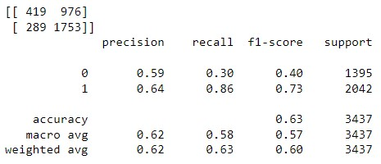

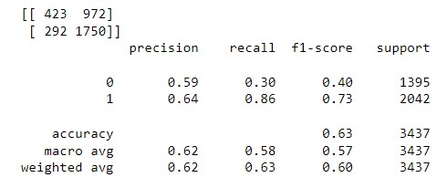

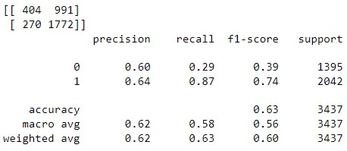

Cat Adoption Predictions
Initial Random Forest
Decision Tree
Tuned Random Forest
Notes:
S: Both the Decision Tree and Initial Random Forest models were able to predict Cat Adoptions with 62% accuracy. The Random Forest model was tuned for best fit hyperparameters, and also had 62% accuracy. The tuned model had slightly higher correct adoption predictions – as seen highlighted in yellow.

Slide 28
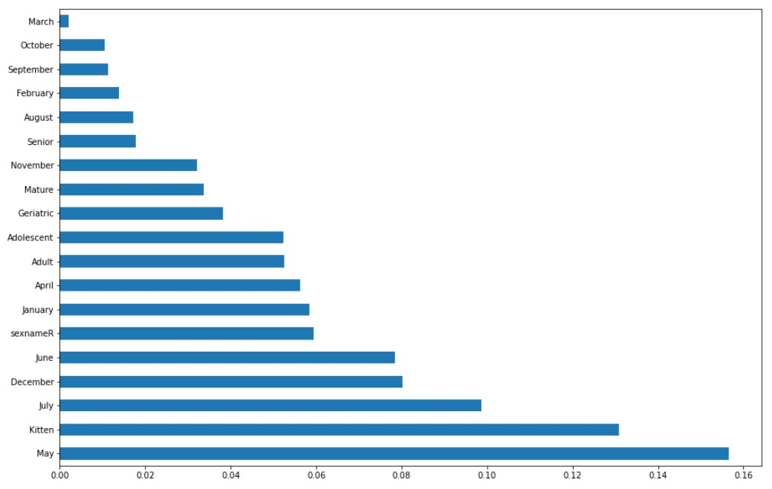
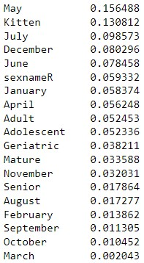
Variable Influences for Cats
Variable
Influence
Feature Importance
Notes:
S: With the random forest model, we were able to determine how each feature influenced adoption predictions.
We discovered that the month of May had the most profound influence on predicting cat adoptions, followed by the Kitten age group, and also the month of July.
It was interesting to see that certain months were highly influential as predictors.

Slide 29
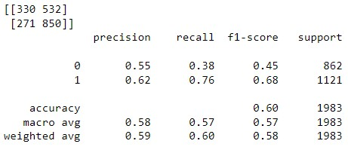
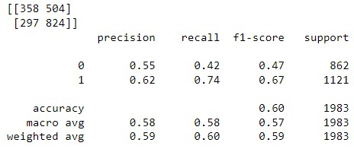
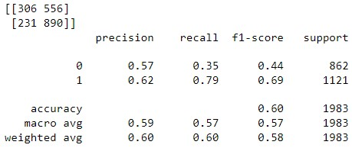

Dog Adoption Predictions
Initial Random Forest
Decision Tree
Tuned Random Forest
Notes:
S: Dog adoptions were predicted with 59% accuracy for both the Decision Tree and Initial Random Forest models.
The Random Forest model - tuned for best fit hyperparameters – had slightly better accuracy at 60%. Highlighted in yellow, we can see that the tuned model had at least 40 more adoptions predicted correctly.

Slide 30
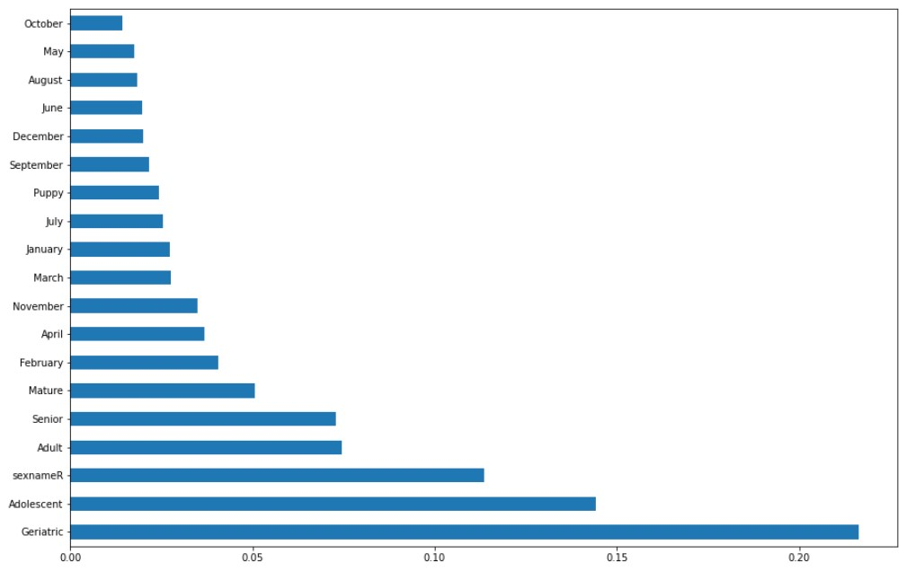
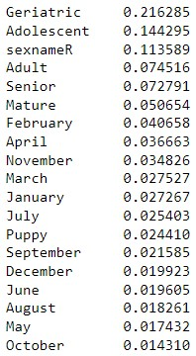
Variable Influences for Dogs
Variable
Influence
Feature Importance
Notes:
S: With the tuned random forest model, we discovered that the Geriatric age group had the most profound influence in predicting dog adoptions. The Adolescent age group and sex category were also some of the higher influential predictors.
We were intrigued to find that most of the age group variables were extremely influential in predicting dog adoptions.

Slide 31
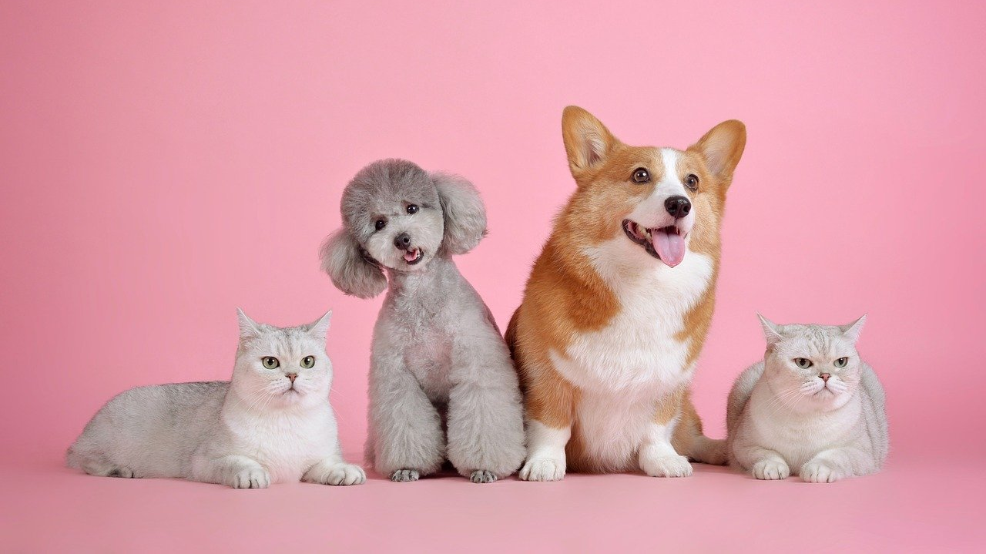
Summary

Slide 32
Cats
Dogs
Highest adoption rates: August
Peak adoptions: August 2019
Adult cats (ages 2-6) were most likely to be adopted (43.85%)
The top shelter intake reasons:
Stray
Litter relinquishment
Incompatible with the owner lifestyle
Unsuitable accommodation
From 2018-2021, stray cat intakes did not change
Highest adoption rates: August and October
Peak adoptions: August 2018
Adult dogs (ages 2-5) were most likely to be adopted (50.33%)
The top shelter intake reasons:
Stray
Incompatible with the owner lifestyle
Police assist
Moving
From 2018-2021, there were significantly less stray dog intakes in 2020 and 2021
Notes:
A: To summarize our findings, we found out that both cats and dogs have high adoption rates in August. Both species had peak adoptions in August, which was contrary to our December predictions.
Adult cats and adult dogs had the highest adoptions by age group. We had predicted that kittens and puppies would have some of the highest adoption rates, however kittens ranked 3rd in adoptions, while puppies ranked the lowest.
Besides stray intakes, incompatibilities with owner lifestyles were a main proponent to both cat and dog surrenders to the shelter.
When it came to stray intakes from 2018 to 2021, cats did not have any significant changes. On the other hand, dogs had a significant decline from 2020 onward.

Slide 33
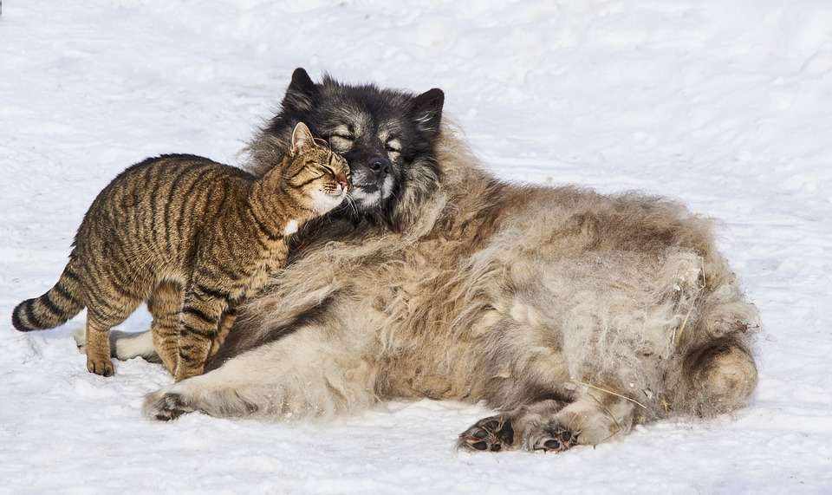
Conclusions

Slide 34
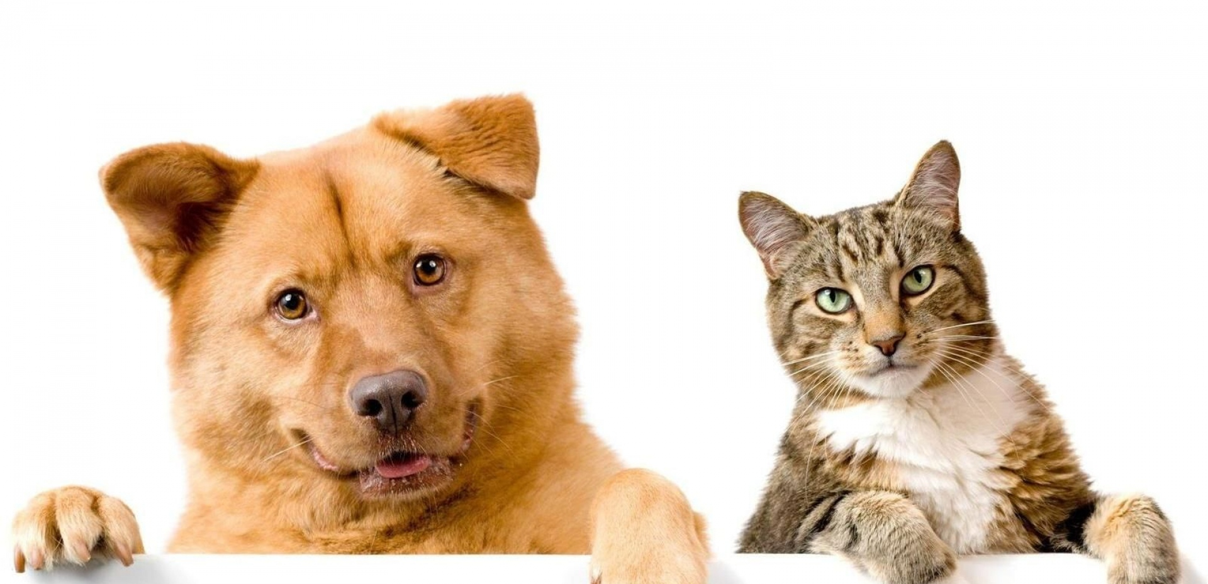
Before buying a cat or dog, consider adopting a furry friend!
A major factor of shelter intakes is due to incompatibilities with owner lifestyle
Warmer weather influences the likelihood of adoptions and stray intakes for both cats and dogs
Notes:
A: We hope that this data provided insight and awareness about shelter trends for cats and dogs.
Please take into consideration that owning a pet takes a lot of responsibility and commitment. If you do decide to own a pet, please visit a local shelter first to find a companion that's right for you!
An additional trend we concluded was that many adoptions and stray intakes for cats and dogs occurred roughly around summertime when the weather became warmer.

Slide 35
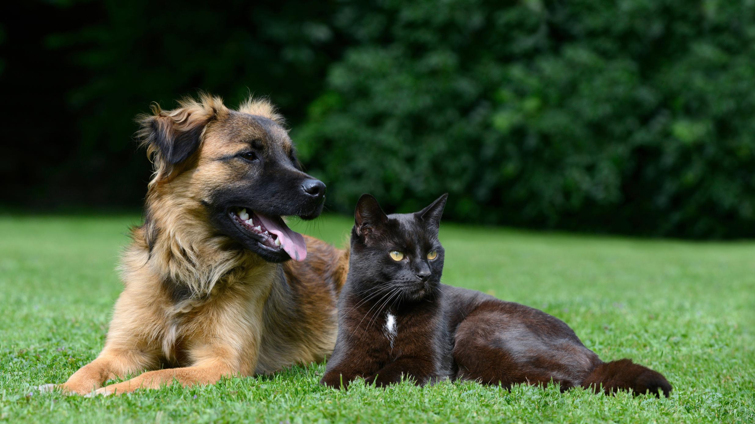
Questions?
Notes:
A: Thank you for listening to our presentation! Please let us know if you have any questions.
If you had more time, what else would you do on this project?
Find data that includes geolocation to compare different shelters in different states, and combine them if necessary
What's next for you?
Meeting weekly with the career and placement support, Taking on another project, Looking for a job, Applying for remote jobs using Otto, Indeed, Monster, LinkedIn, and ZipRecruiter
What was the most difficult part of this project?
Figuring out which analyses would be appropriate for our evaluation questions

